Slide 1


Web Project
Chatter :- A Chatting website
BY:- Meet Patel (21BCP360)

Slide 2


About Chatter
It is a basic chatting application made using html , CSS, JavaScript and php.
It contains Login page, User registration and main application.

Slide 3
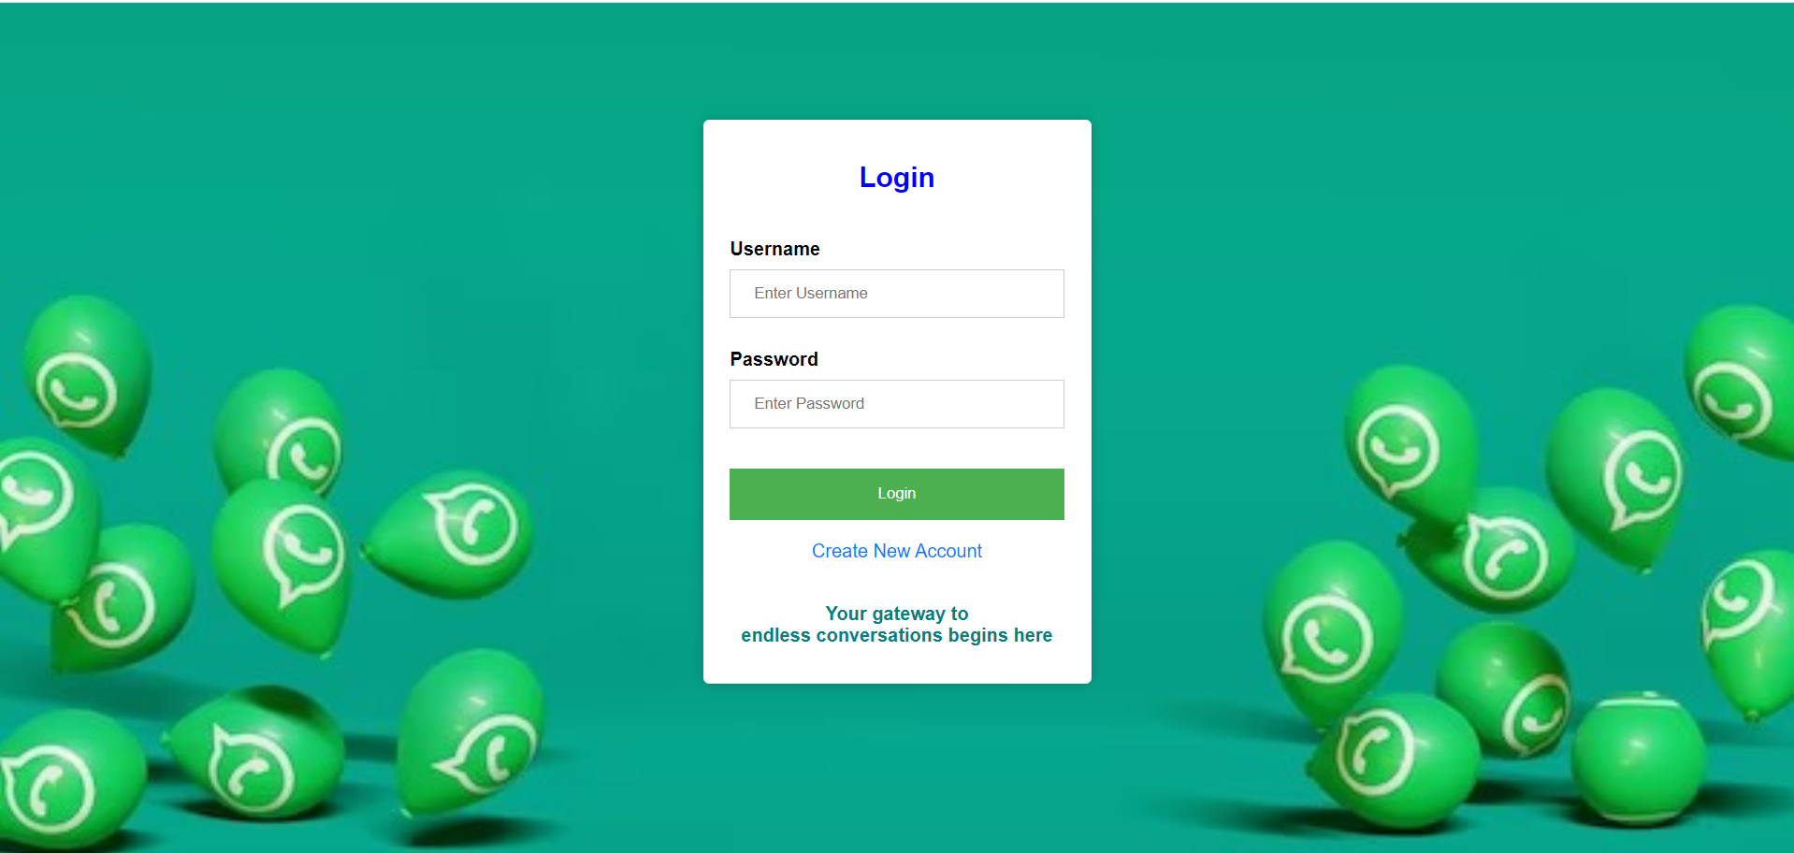
Login Page
A Simple Web Login Interface
Designed using HTML and CSS
Allows users to log in or create a new account
Utilizes a MySQL database for user data.
Engaging design with customizable options.

Slide 4
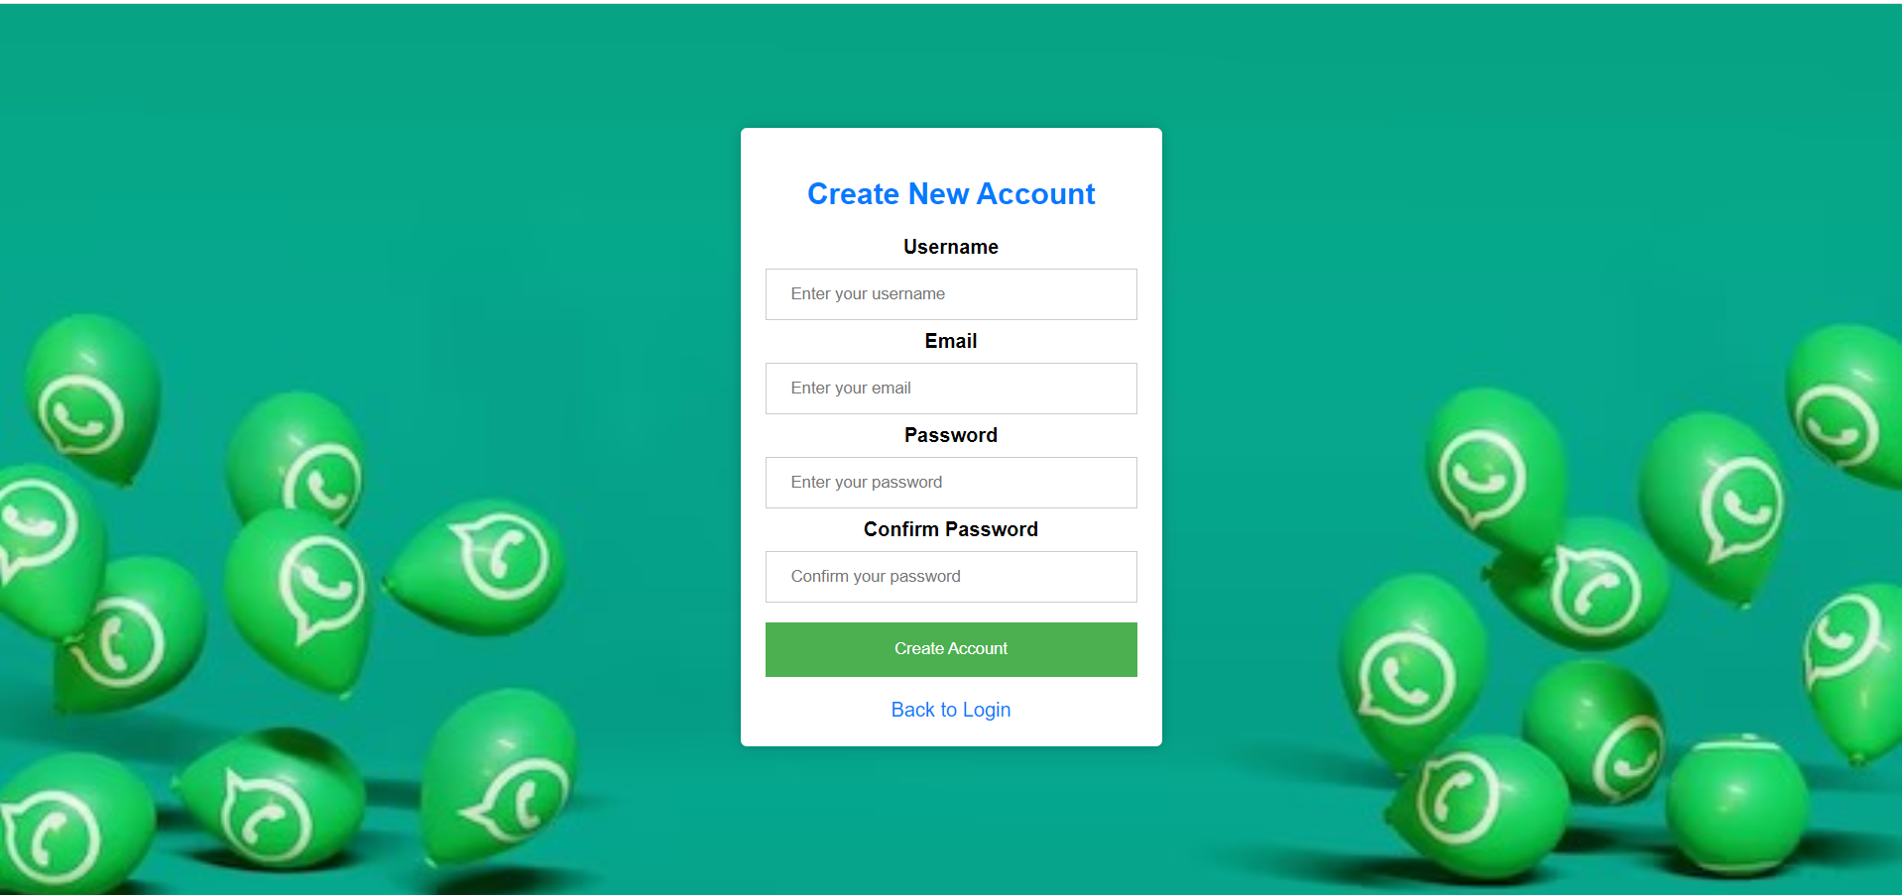
Create New Account Page
User-friendly interface for creating a new account.
Password validation to ensure matching passwords.
Secure database integration.
Option to return to the login page.

Slide 5
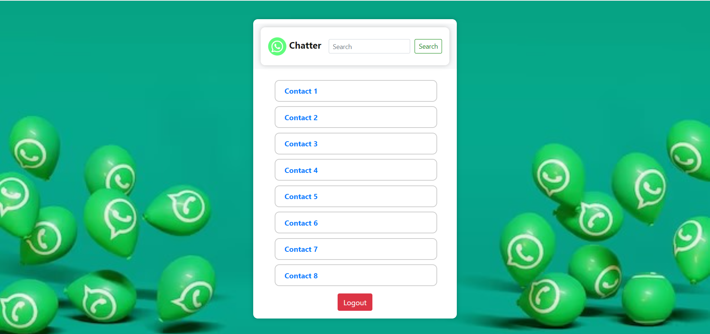
Chatter – A chatting website
User-friendly chat interface
Contact search feature for easy navigation
Secure and organized communication
Customizable, responsive design

Slide 6
Chatter – A chatting website
Organized messaging with contacts
Border-radius and shadow effects for aesthetics
Navbar & Search
Navigation bar with a logo
Search functionality to find contacts
List of contacts with clickable links
Securely log out of the application
Redirects to the login page

Slide 7
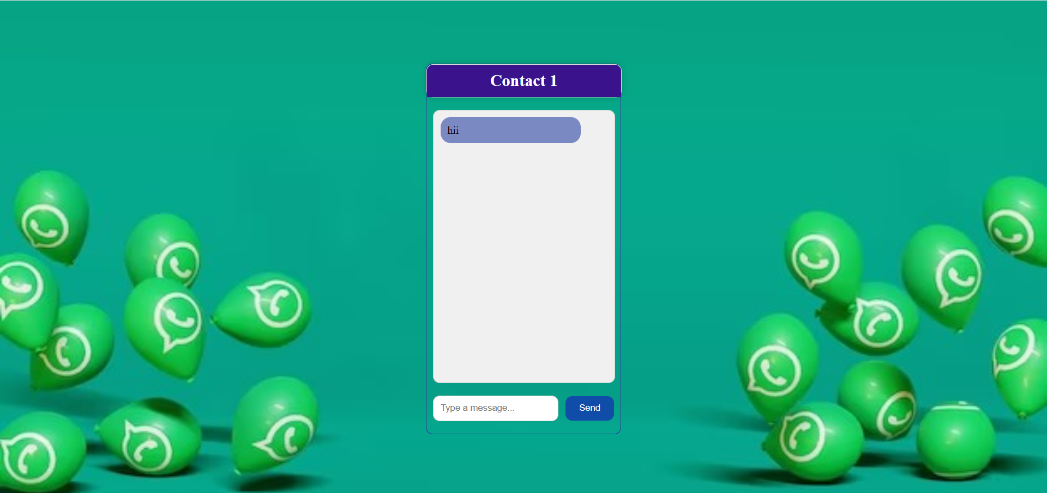
Contact
Centered content with background image.
Border radius and shadow effects for a modern look.
White chat box with rounded corners.
Header with a distinctive color.
Flexible input container with text input and send button.
Messages displayed with a distinctive background.

Slide 8
Future Plans
Implement "Forgot Password" functionality in the login page.
Add an "Add User" button in the Chatter main interface.
Enhance Chatter with features like "Sharing," "Camera," and "Call."
Connect the application to a database for chat data.
Improve the user interface for a better user experience.

Slide 9
Thank You!!

